Slide 1
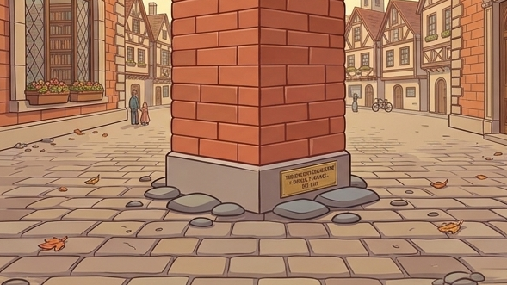
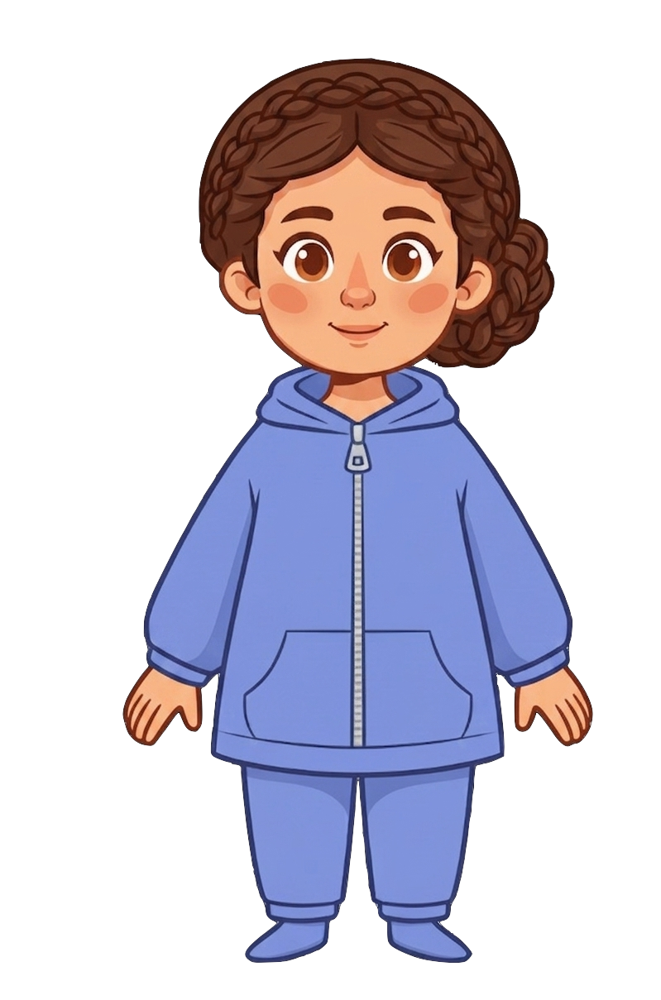
This is Catherine.

Slide 2


Catherine has 7 cookies.

Slide 3
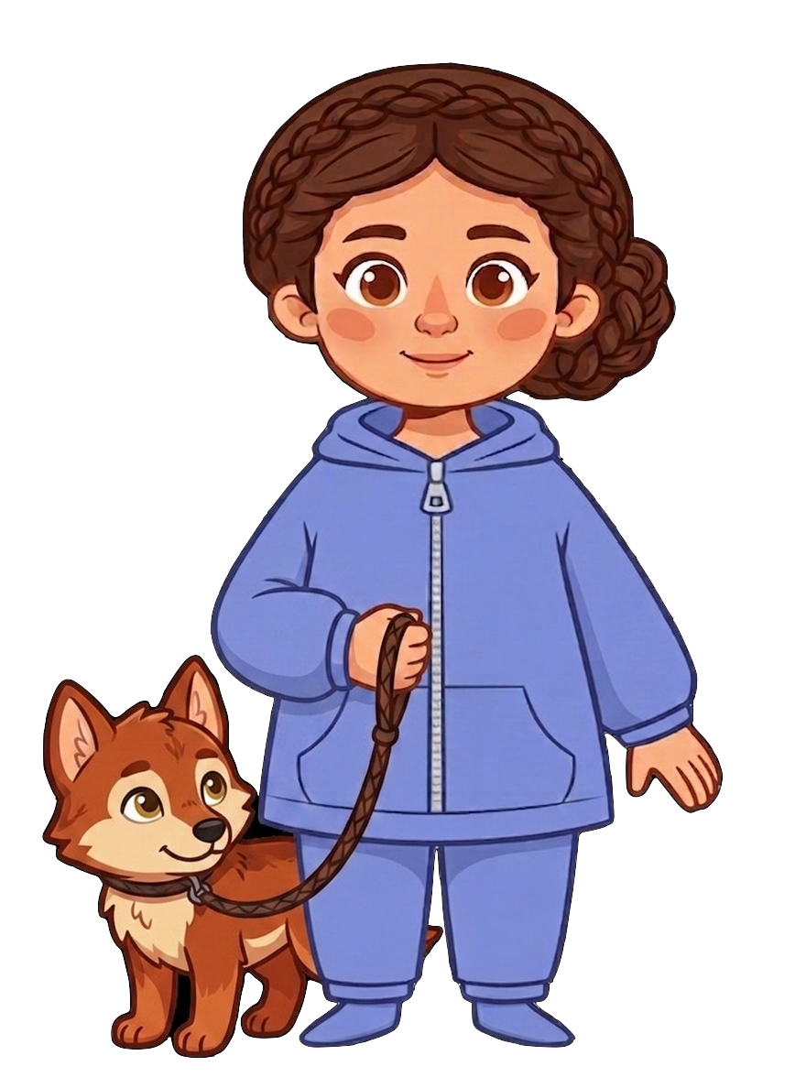
Catherine has a pet wolf.

Slide 4
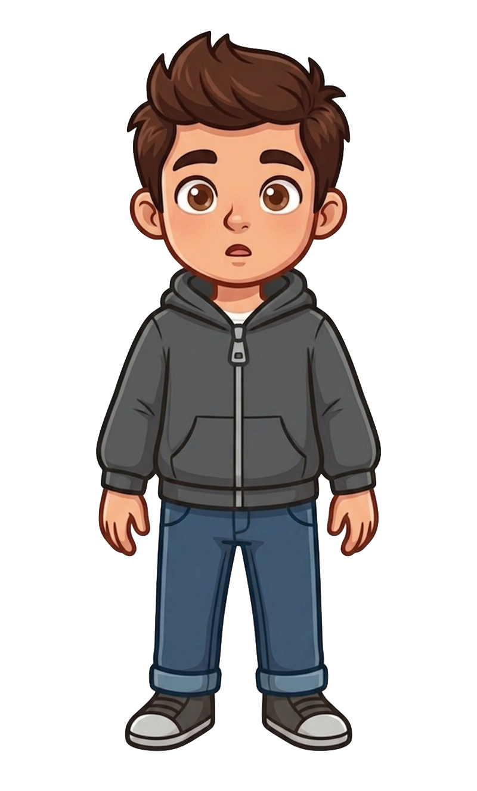
This is Andy.

Slide 5
Andy has 7 cookies.

Slide 6
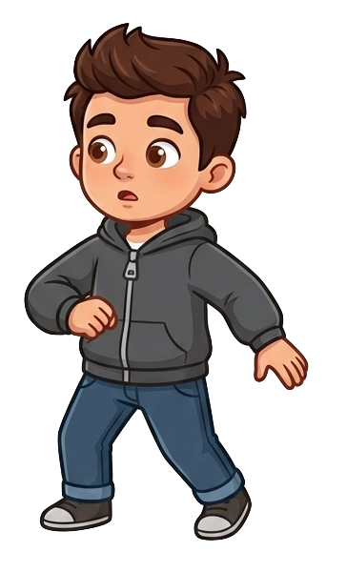
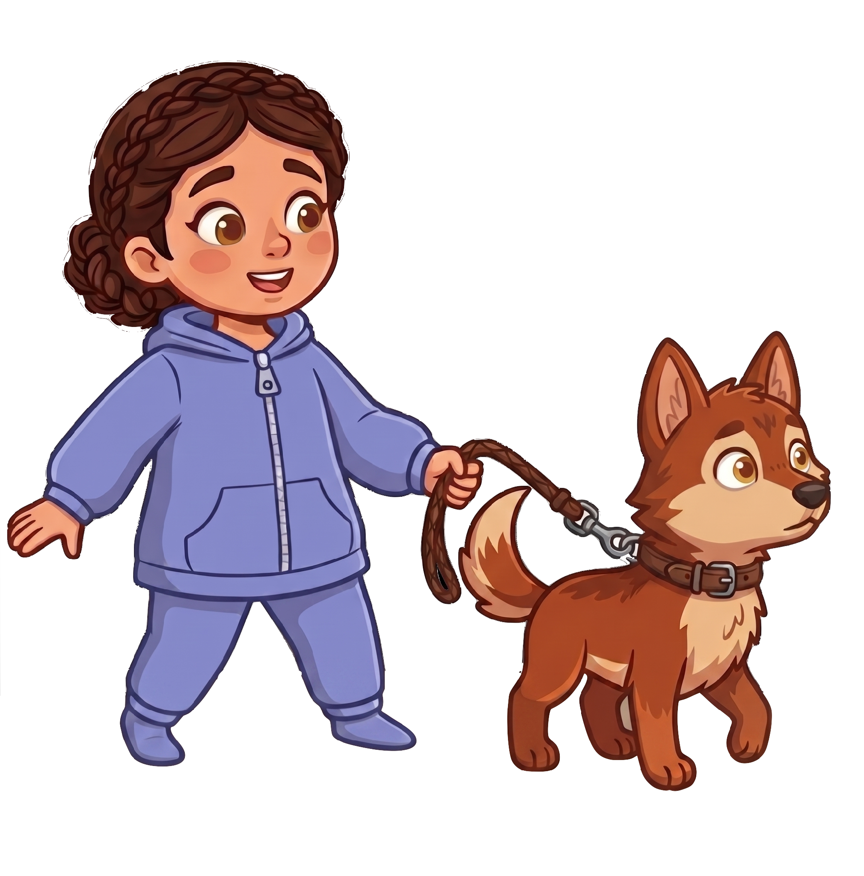
Andy and Catherine walk down the same street.

Slide 7
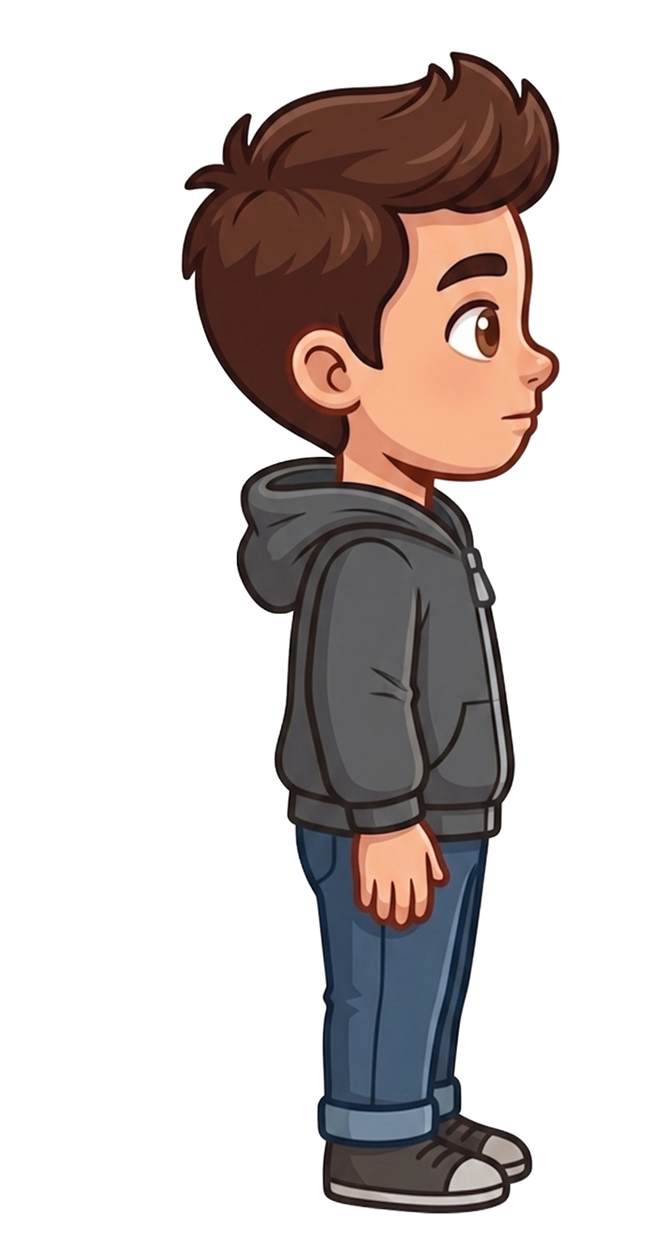
Andy puts down his cookies and looks to the right.

Slide 8
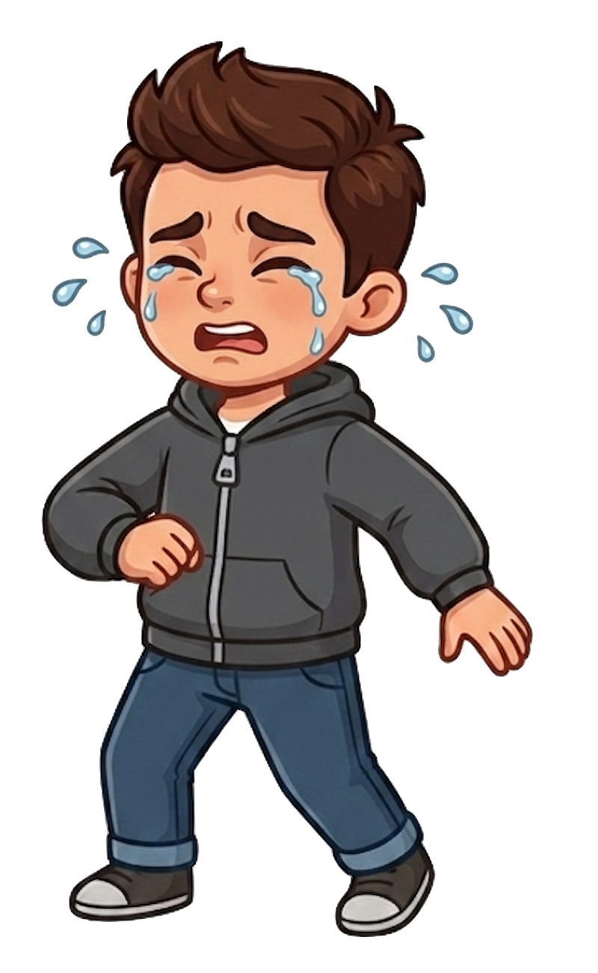
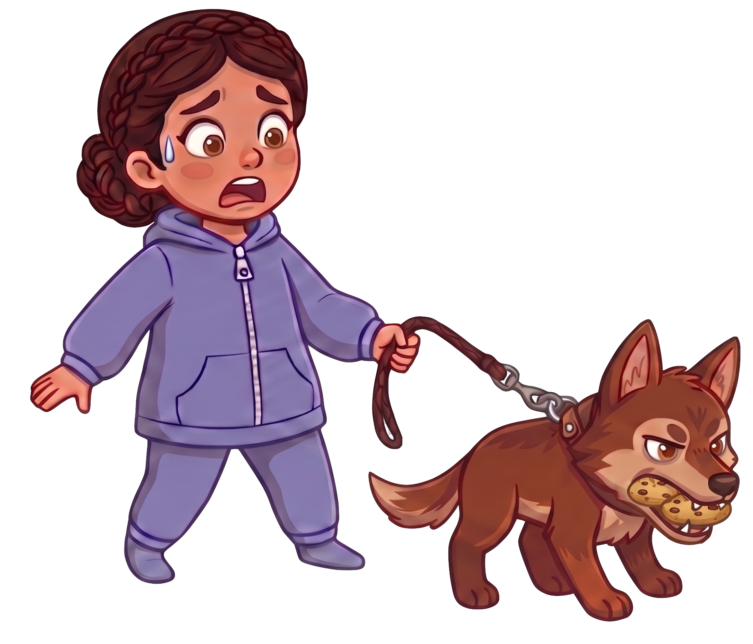
Oh no! The wolf eats 2 of Andy’s cookies!

Slide 9
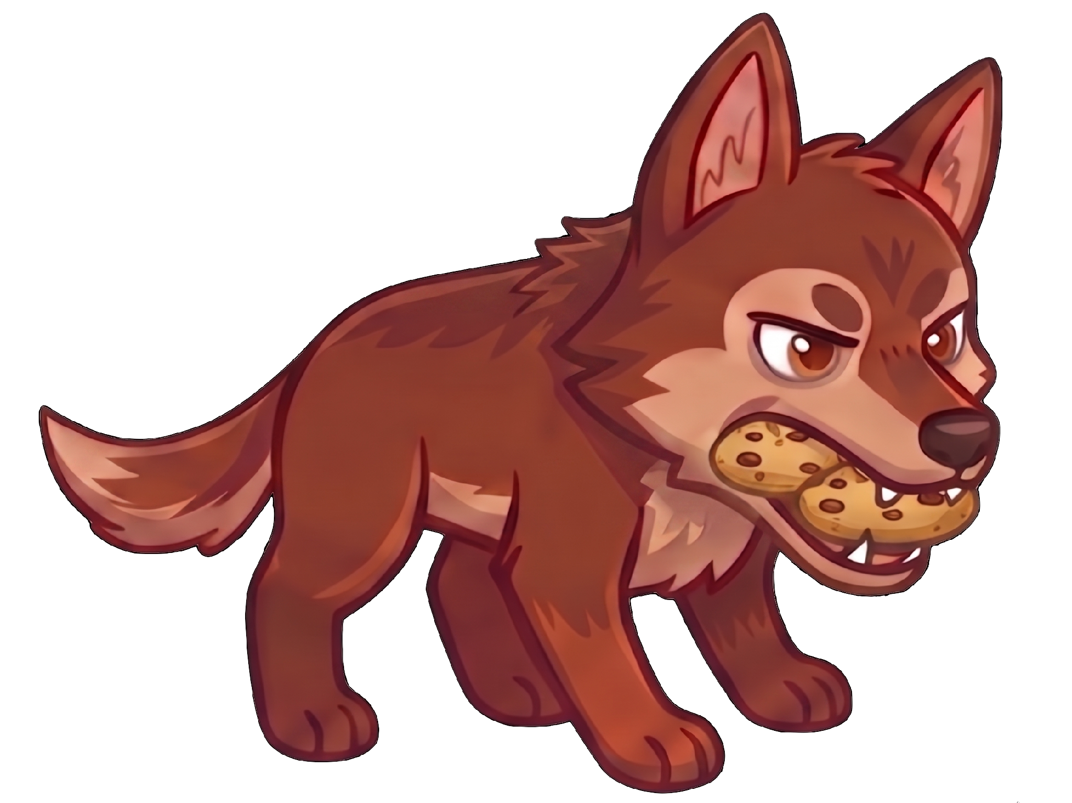
Catherine still has 7 cookies. Andy now has 5 cookies.

